Slide 1
System Design

Slide 2
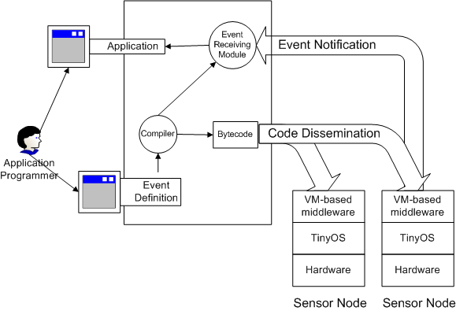
System Architecture

Slide 3
API of the Java
interface Notification {
public void notify (Event e);
}
abstract class Subscriber {
public boolean subscribe (String edl, Notification notifier);
}

Slide 4
How to Use the API
Write a class to implement the notify method in Notification interface.
Call the subscribe function provided by the middleware.
Provide the EDL program when calling subscribe function

Slide 5
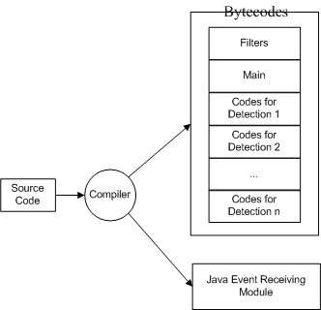
Compiler Architecture

Slide 6
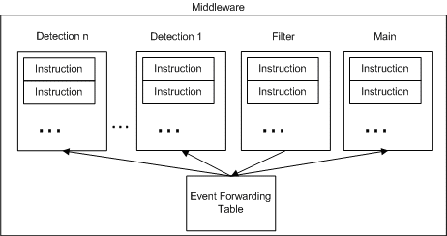
VM Architecture

